Slide 1
Simple GA Mechanisms
Tian-Li Yu
tianliyu@cc.ee.ntu.edu.tw
Department of Electrical Engineering
National Taiwan University
Acknowledgment
David E. Goldberg’s slides for his GA course.
Ying-Ping Chen’s slides for his EC course.

Slide 2
Simple GA (SGA)
Holland’s early idea of genetic plans.
Simple GA or canonical GA.
Refer to a class of GAs that do not involve problem structure learning.

Slide 3
Three Basic Operators in SGA
Selection (Reproduction)
Crossover (Recombination)
Mutation
Assumptions for now:
Binary coding
Fixed population size
Fixed chromosome length

Slide 4
SGA Flow
Evaluation
Selection
Initialization
Replacement
Until termination
Crossover
Mutation

Slide 5
Selection/Reproduction
The survival-of-the-fittest step.
Emphasize genetic influence of the better individuals on future generations.
Different mechanisms used, but the main idea is to give more copies to better guys.

Slide 6
SGA: Roulette-Wheel Selection
Redistribute population according to f.
Like spinning a weighted roulette wheel.

Slide 7
SGA: Truncation Selection
Divide the population evenly into two groups according to the fitness.
Individuals in the group with lower fitness die.
Individuals in the group with higher fitness get reproduced as two copies.
1
1
0
1
0
1
1
1
0
1
0
1
Higher fitness
0
1
1
0
1
0
0
1
1
0
1
0
1
0
0
1
0
1
1
1
0
1
0
1
Lower fitness
0
1
1
0
0
0
0
1
1
0
1
0

Slide 8
Crossover
The mating step.
Generate new chromosomes by combining potential genes.
Innovation is combining great ideas
Camera cell phones
Data compression and music
Game theory and economics

Slide 9
SGA: One-point Crossover
Two individuals mated at random.
Cross site selected at random.
Cut and splice pieces of one parent to those of another.
1
1
0
1
0
1
1
1
0
1
1
0
0
1
1
0
1
0
0
1
1
0
0
1
1
1
0
1
0
1
1
1
1
0
1
0
0
1
1
0
1
0
0
1
0
1
0
1

Slide 10
Mutation
An insurance policy against lost genetic information.
Enhancing the exploration.
The occurrence probability needs to be small.

Slide 11
SGA: Bit-wise Simple Mutation
With a small probability, randomly alter a gene.
For binary, 0→1, or 1 → 0.
1
1
0
1
1
0
1
1
0
1
0
0
0
1
1
0
0
1
1
1
1
0
0
1
1
1
1
0
1
0
1
1
1
1
1
0
0
1
0
1
0
1
0
0
0
1
0
1

Slide 12
One-generation simulation of a SGA
Initialization
1
1
0
1
0
1
4
3
3
2
0
1
1
0
1
0
1
0
0
1
0
1
0
1
1
0
0
0

Slide 13
One-generation simulation of a SGA
Initialization
selection
1
1
0
1
0
1
1
1
0
1
0
1
0
1
1
0
1
0
0
1
1
0
1
0
1
0
0
1
0
1
1
1
0
1
0
1
0
1
1
0
0
0
0
1
1
0
1
0

Slide 14
One-generation simulation of a SGA
Initialization
After selection
1
1
0
1
0
1
1
1
0
1
0
1
0
1
1
0
1
0
0
1
1
0
1
0
1
0
0
1
0
1
1
1
0
1
0
1
0
1
1
0
0
0
0
1
1
0
1
0

Slide 15
One-generation simulation of a SGA
Initialization
After selection
1
1
0
1
0
1
1
1
0
1
0
1
1
1
0
1
1
0
0
1
1
0
1
0
0
1
1
0
1
0
0
1
1
0
0
1
1
0
0
1
0
1
1
1
0
1
0
1
1
1
1
0
1
0
0
1
1
0
0
0
0
1
1
0
1
0
0
1
0
1
0
1
crossover

Slide 16
One-generation simulation of a SGA
Initialization
After selection
After crossover
1
1
0
1
0
1
1
1
0
1
0
1
1
1
0
1
1
0
0
1
1
0
1
0
0
1
1
0
1
0
0
1
1
0
0
1
1
0
0
1
0
1
1
1
0
1
0
1
1
1
1
0
1
0
0
1
1
0
0
0
0
1
1
0
1
0
0
1
0
1
0
1

Slide 17
One-generation simulation of a SGA
Initialization
After selection
After crossover
1
1
0
1
0
1
1
1
0
1
0
1
1
1
0
1
1
0
1
1
0
1
0
0
0
1
1
0
1
0
0
1
1
0
1
0
0
1
1
0
0
1
1
1
1
0
0
1
1
0
0
1
0
1
1
1
0
1
0
1
1
1
1
0
1
0
1
1
1
1
1
0
0
1
1
0
0
0
0
1
1
0
1
0
0
1
0
1
0
1
0
0
0
1
0
1
mutation

Slide 18
One-generation simulation of a simple GA
Initialization
After selection
After crossover
After mutation
4
3
3
2
1
1
0
1
0
1
1
1
0
1
0
1
1
1
0
1
1
0
1
1
0
1
0
0
3
4
5
2
0
1
1
0
1
0
0
1
1
0
1
0
0
1
1
0
0
1
1
1
1
0
0
1
1
0
0
1
0
1
1
1
0
1
0
1
1
1
1
0
1
0
1
1
1
1
1
0
0
1
1
0
0
0
0
1
1
0
1
0
0
1
0
1
0
1
0
0
0
1
0
1
Average fitness: 3
Average fitness: 3.5

Slide 19
Each GA Operator Alone
Selection alone
What will you get by doing successive generations of selection or reproduction alone.
An expensive way of choosing the best from a finite list.
Crossover alone
Suppose you have 2 individuals, 111111 and 000000.
Random shuffle by itself.
Mutation alone
Suppose you start with 100 copies of 111111.
Random walk by itself.

Slide 20
Are We Just Doing Something Random Here?
Uninteresting + uninteresting = Interesting?
The mystery of GA power: How can individually uninteresting operators do something useful?
Human innovation as plausible intuitive explanation of power.
2 types of innovation:
Selection + Mutation: Hillclimbing
Selection + Crossover: Discontinuous improvement

Slide 21
Selection + Mutation: Hillclimbing
Evolutionary strategies (Rechenberg, 1984).
Takes small steps like pattern or gradient search.
No jumps to interesting areas without recombination.
Human improvement seems more directed than random.

Slide 22
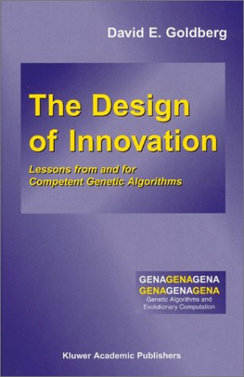
Selection + Crossover: Discontinuous Improvement
GA Power= Selection + Recombination
Something like human innovation or invention.
Are random combination enough?
No, it should be directed, but at what?

Slide 23
Reality Therapy
Genetics and natural selection are used analogically, & simple GAs an abstraction of classical genetics.
Chromosomes, genes, alleles, and locus usually fixed.
Expression and molecular substrate usually ignored.
Some exceptions: messy GAs, GP dominancediploidy work.
How do simple GAs depart from real genetics?

Slide 24
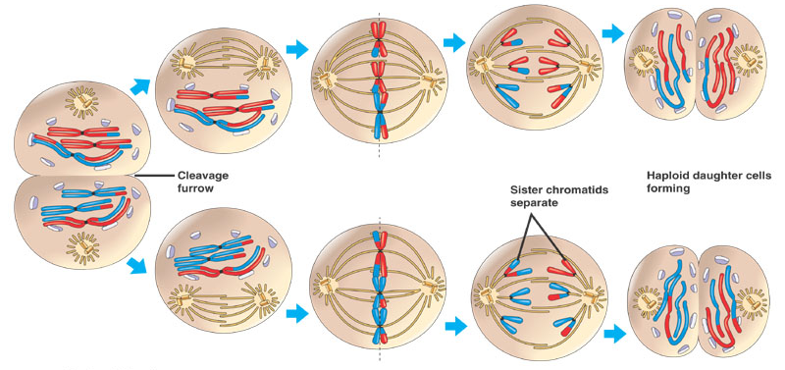
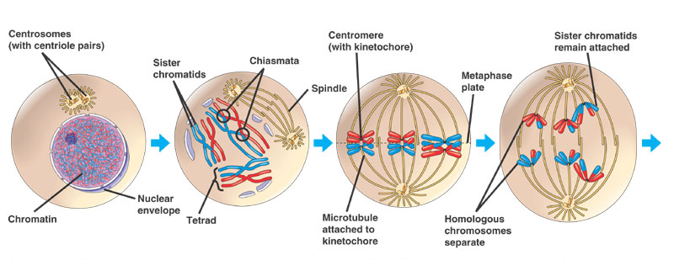
SGAs Ignore Meiosis
Preservation of genetic material through halving and sex (doubling).
Prokaryotic recombination can occur by separate cutting and splicing.
Gallant's Biology Stuff http://kvhs.nbed.nb.ca/gallant/biology/biology.html

Slide 25

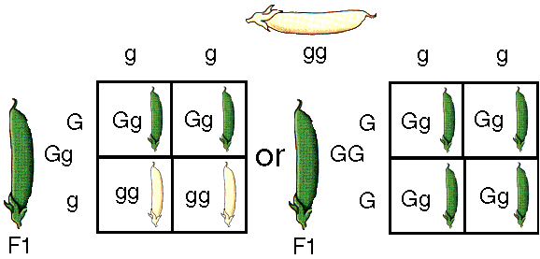
SGAs Ignore Dominance and Diploidy
Where are Mendel and his pea plants?
Dominant gene masks expression of a recessive.
Will examine modified SGA with dominance and diploidy later.
AbCde | → AbCDe
AbcDe
By Steve Berg
http://bio.winona.edu/berg/Fac_sb.htm

Slide 26
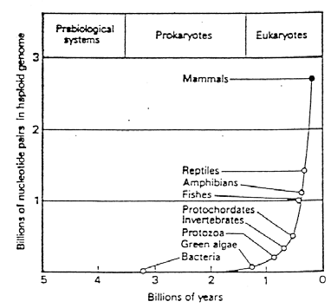
SGAs Ignore Growing Complexity
In short run, rabbits beget rabbits.
In long run, simple organisms beget more complex organisms.
Growth of haploid nucleotide pair count
de Duve, C. (1984). A guided tour of the living cell. New York: Rockefeller University Press.

Slide 27
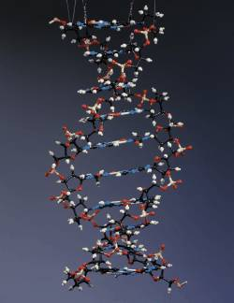
SGAs Ignore Molecular Substrate
DNA, RNA, amino acids, proteins, etc.
T=thymine, C=cytosine, G=guanine, A=adenine
LBL Research Review, Vol. 12, Nos. 3/4, Fall/Winter 1987, cover

Slide 28
Yet SGAs Are Still Tough
Despite ruthlessness of the abstraction, SGAs work remarkably well.
Art advanced because of abstraction and understanding that resulted.
Theory help us understand what we have and what we are missing.
Do we care if SGAs resemble nature, or if SGAs solve our problems?

Slide 29
Science vs. Engineering
For many years, GAs simply work without knowing why.
Analyzing GAs is difficult. Approximate statistics do not give tight bounds.
Does that hinders us from using/developing GAs?
Wright brothers & airplanes
We do what we can do
Good engineering with as many theories and analyses as we can develop

Slide 30
What’s Next
A little bit more on GA operators.
Selection
Stochastic remainder selection
Stochastic universal selection
Tournament selection w/wo replacement
Crossover
Multi-point crossover
Uniform crossover
Replacement
Elitism
Termination condition

